Slide 1

Smart Home

Slide 2

Introduction
What is a smart home?
A smart home is a home automation system that uses advanced technologies to operate household activities remotely and autonomously. ¹

Slide 3
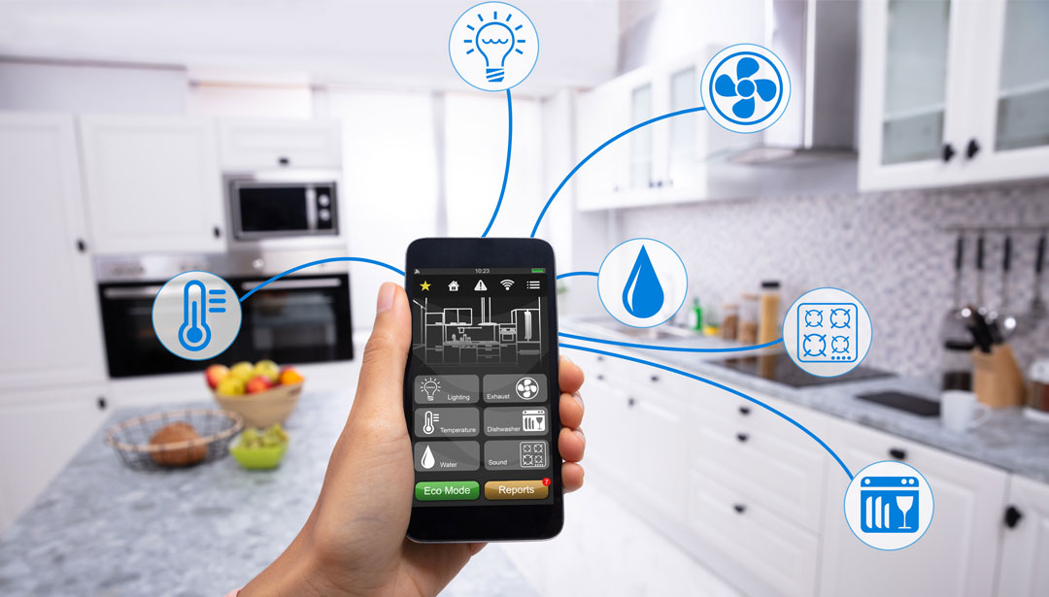
What can a smart home do?
[Anon 2020]

Slide 4

NETWORKING AND COMMUNICATION

Slide 5
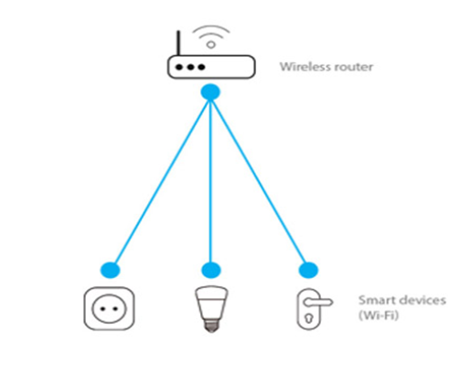

Slide 6
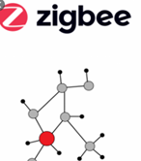
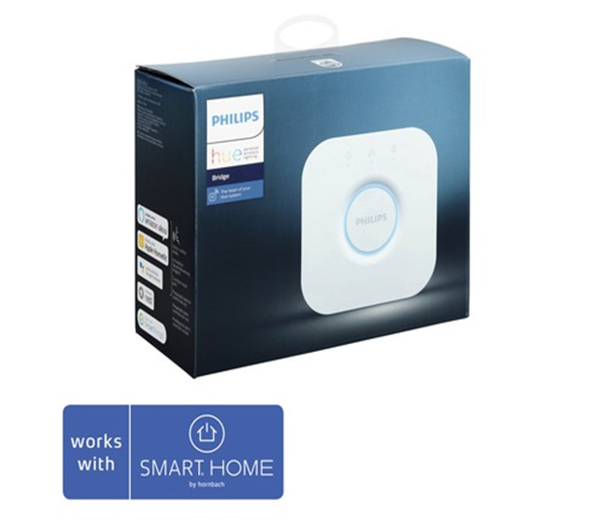


Slide 7
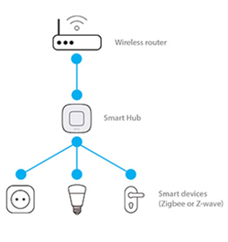

Slide 8


Slide 9
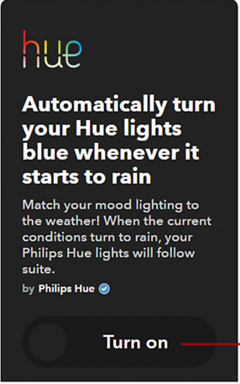

Slide 10
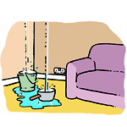
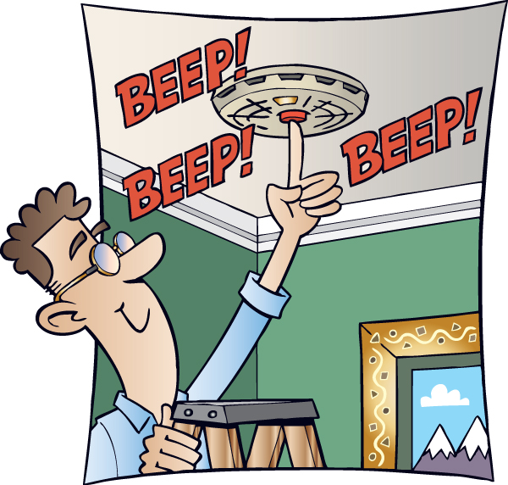
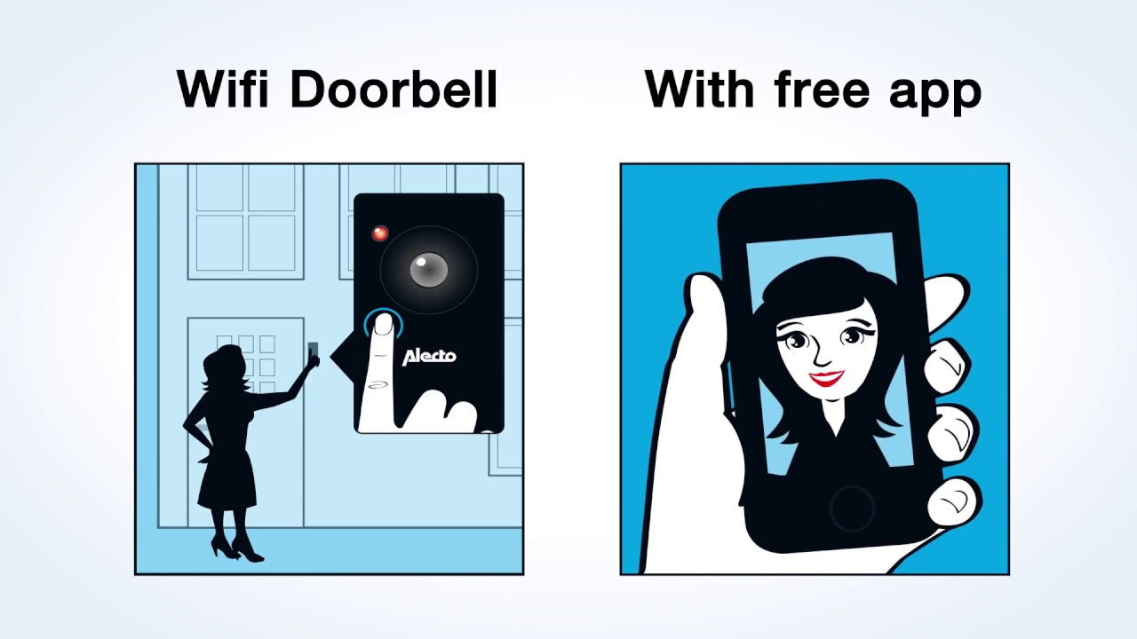
Sensors
1. Fire/CO detection
2. Leak/moisture detection
3. Window & door open and close
4. Video doorbell

Slide 11


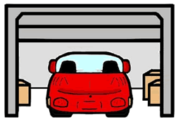
Sensors
5. Smart thermostat
6. Motion sensors
7. Smart garage door
8. Intercom/hub

Slide 12
Advantages
Convenience. (Control Everything Fast & Easy)
Flexibility. (Voice Control , Apps)
Security & Safety. (Smart Doorbell)
Cost Saving.(Smart Light , Automated heating system)
Task Completing.(Automated Vacuum)
Provide Care.(Smart Caring Home)
Available Application.(Various Apps for Montoring)

Slide 13
Disadvantages
Security Concern.(Hacker getting Access, Data Stealing)
No Standard System for the Gadgets.
Loss of control system. (Control Device lost or Network fault)
Private Privacy invasion.(Identity Theft, Smart Speaker always Listening!)
Power & Technology failure.(Power Outage)
Internalization. (Connection difficulty, Slow Connection)

Slide 14
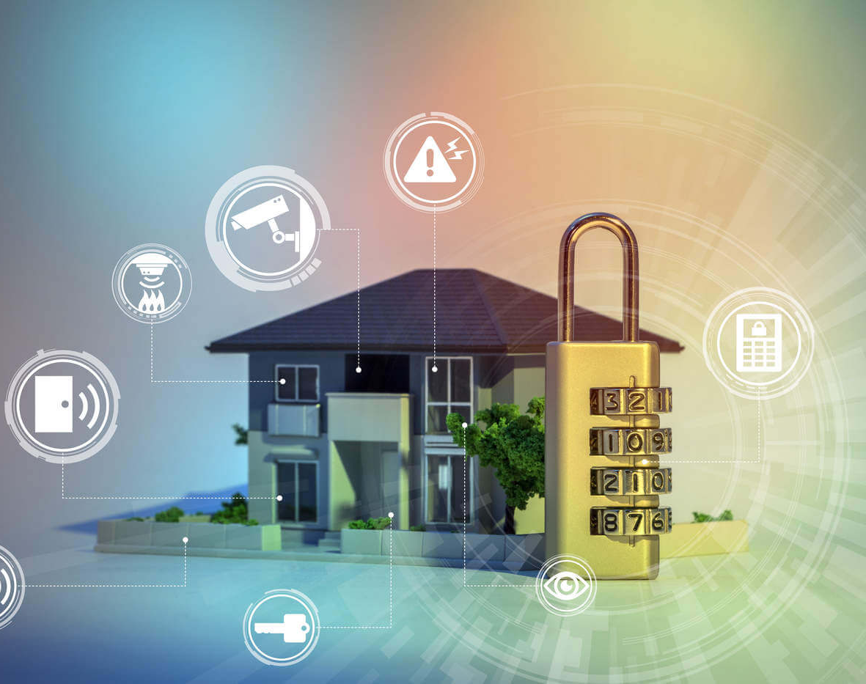
Security
Encrypted network.
Improved Surveillance
Face recognition
Fire detection and control system
Control energy waste
Prevent Unauthorized access.
Alert owner if there is a suspicious activities

Slide 15
Referecnces
1. Harper, R. Inside the Smart Home; Springer Science & Business Media, 2006.
2. Anon, 2020. https://readersdigest.de/at/wissen-tipps/haus-garten/item/was-im-smart-home-smart-werden-kann,
3. Kft, L. Beleben Sie den Platz! https://www.eotvoshaz.hu/ (accessed Nov 18, 2020
https://www.investopedia.com/terms/s/smart-home.asp
https://www.androidauthority.com/what-is-a-smart-home-806483/
https://home.howstuffworks.com/smart-home.htm#pt3
https://www.homeridersystems.com/home-automation/what-is-the-risk-associated-with-smart-technology/
https://bluespeedav.com/blog/item/7-greatest-advantages-of-smart-home-automation
https://www.ibm.com/blogs/internet-of-things/sensors-smart-home/
http://clipart-library.com/
https://www.cleanpng.com/
https://www.carolinacountry.com/carolina-country-feed/7-install-a-smart-thermostat

Slide 16
4. Micheal R. Miller Jun 2017 https://learning.oreilly.com/library/view/my-smart-home/9780134752792/ch14.html​
5. M. Schiefer, "Smart Home Definition and Security Threats," 2015 Ninth International Conference on IT Security Incident Management & IT Forensics, Magdeburg, 2015, pp. 114-118, doi: 10.1109/IMF.2015.17.

